Slide 1
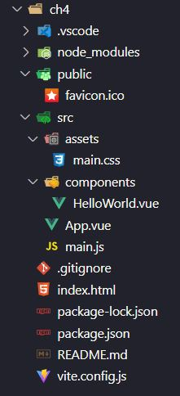
Directory Structure
npm init vue@latest

Slide 2
Directory Structure
ch4 – This is Project Folder
node_modules – It contains all packages and dependencies installed.
public -
favicon.ico – It’s a favicon.
src
assets
logo.svg – Vue logo file
main.css – It’s a css file related to App.vue but its global.
components
HelloWorld.vue
App.vue – It’s Parent component of your vue app
main.js – It’s the JavaScript entry Point.
.gitignore – It is used when you want to ignore git push.
index.html – This file holds the HTML template of our app.
package-lock.json – Its version control package json file
package.json – All dependencies mentioned in this file.
README.md – It readme file
vite.config.js – Its Vite Config File

Slide 3
main.js
import { createApp } from 'vue'
import App from './App.vue'
import './assets/main.css'
createApp(App).mount('#app’)
createApp function is used to create New Application Instance. We can pass a component in createApp Function. We can write multiple application instances.
Example:-
createApp(App1).mount('#app1’)
createApp(App2).mount('#app2’)
createApp(App3).mount('#app3’)
mount() Method renders application instance. It expects a "container" argument, which can either be an actual DOM element or a selector string. The content of the app's root component will be rendered inside the container element.

